Slide 1
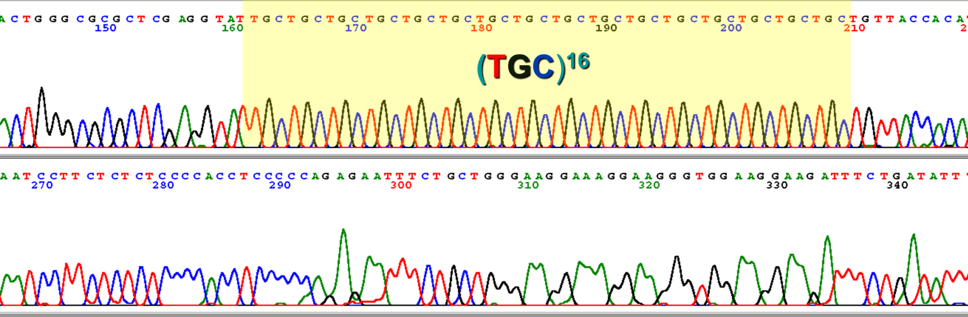
Lab 9: Introduction to Population Genetics using Microsatellites
BIOL4174/5174 Conservation Genetics Spring 2018

Slide 2
Microsatellites
Short, repeating DNA sequences spread throughout the genome
Repeats of short motif of 2-6 bases (e.g. ATATATATATATAT or GCAGCAGCAGCAGCAGCA)
Mutations add or remove repeats

Slide 3
Microsatellites

Slide 4
Microsatellites – High mutation rates
High mutation rate = lots of fine-scale variation

Slide 5
Utility of ‘fast-evolving’ markers
Fine-scale population structure within species
Examining admixture between populations/ identifying contemporary migrants
Infer recent demographic history (e.g. bottlenecks)
Inbreeding/ relatedness of individuals
All types of questions in which slower-evolving markers would yield insufficient signal (e.g. too short timescale for mutations to accumulate)

Slide 6
How do we sequence them?
PCR-amplify them with dye-labeled primers
Measure fragment size for each amplified fragment (different fragment lengths = different alleles)
Nowadays we do this with automated sequencer… Used to run manually on a gel

Slide 7
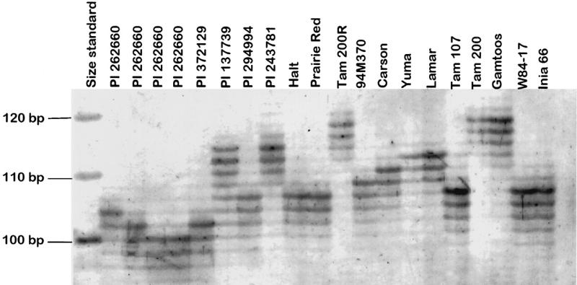
How do we sequence them?

Slide 8
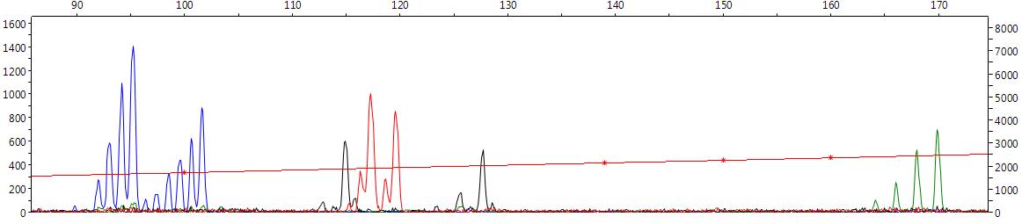
How do we sequence them?
Different color for different loci…
X-axis = fragment length (bp)
Y-axis=intensity
DNA polymerase doesn’t amplify simple repeats well, so we often get amplified fragments of an incorrect length (=‘stutters’)

Slide 9
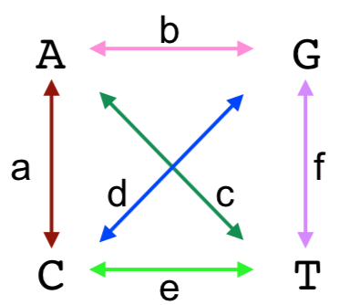
Disadvantages of using msats
Mutate too quickly for inferring deeper relationships (=noisy data)
Difficult to model how they evolve
Nucleotide Substitutions

Slide 10
Disadvantages of using msats
Mutate too quickly for inferring deeper relationships (=noisy data)
Difficult to model how they evolve
Nucleotide Substitutions

Slide 11
How do msats evolve?
Stepwise (add/remove 1 repeat at a time)?

Slide 12
How do msats evolve?
Stepwise (add/remove 1 repeat at a time)?
‘Stepwise Mutation Model’ (SMM)
Ancestral Sequence
TATG
TATG
TATG
TATG
-1
+1
Mutant 1
Mutant 2
TATG
TATG
TATG
TATG
TATG
TATG
TATG
TATG
-1
Mutant 3
Assumed due to replication ‘slippage’ by DNA polymerase
TATG
TATG

Slide 13
How do msats evolve?
Growth by >1 unit at a time?

Slide 14
How do msats evolve?
Growth by >1 unit at a time?
Two-phase Model (TPM)
Ancestral Sequence
TATG
TATG
TATG
-1
+2
Rate p
Rate p-1
Mutant 1
Mutant 2
TATG
TATG
TATG
TATG
TATG
TATG
TATG
+1
Mutant 3
Two rates: Growth by 1 and growth by >1
TATG
TATG
TATG

Slide 15
How do msats evolve?
Is it length dependent?

Slide 16
How do msats evolve?
Is it length dependent?
Centrally directed mutation (CDM)
Short alleles more likely to grow
Long alleles more likely to shrink

Slide 17
How do msats evolve?
We don’t know??

Slide 18
How do msats evolve?
We don’t know??
Infinite alleles model (IAM)
All mutations occur at equal probability
Repeat of 14 is assumed equally ‘related’ to repeat of 17 and repeat of 32
All that matters is ‘identical’ vs ‘different’

Slide 19
How do msats evolve?
Why do we care?
It means we cannot accurately construct a rate matrix and infer phylogeny from msats
Calculating genetic distance requires rate correction (remember saturation?)
Different measures of genetic distance assume different models of microsatellite evolution

Slide 20
Today’s Objectives
Test usability of our microsatellite dataset for analysis
Do our loci violate assumptions underlying the analyses we will use?
Are our loci selectively neutral?

Slide 21
Today’s Objectives
Generate summary statistics to get a basic understanding of the information content of our data
How much genetic diversity is within populations?
How different are populations/ samples?
Is there a signal of spatial segregation? Or isolation-by-distance?

Slide 22
Validating our data: HWE
Hardy-Weinberg Equilibrium
Describes how genotype frequencies should be distributed in an idealized population with no evolution
No selection
No mutation
No population structure
No gene flow
No meiotic drive (unequal transmission of parental alleles to offspring)

Slide 23
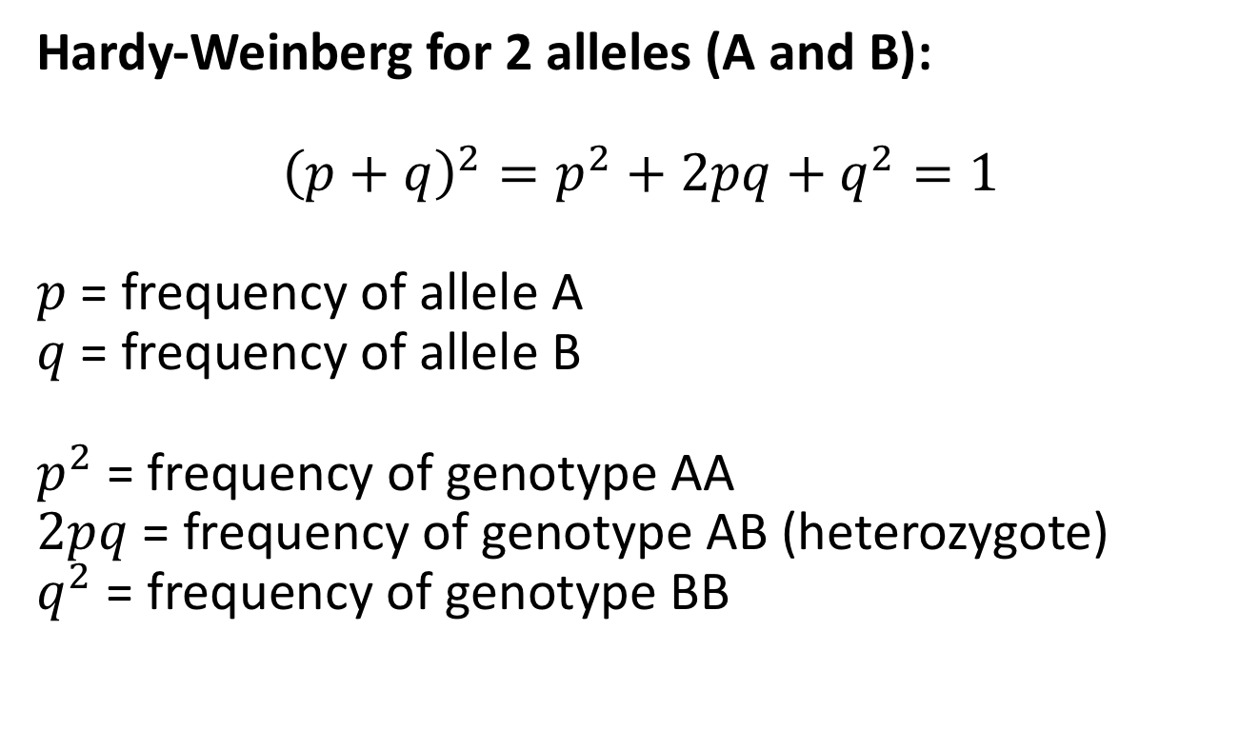
Validating our data: HWE
Hardy-Weinberg for 2 alleles (A and B):
$${\left(p+q\right)}^{2}=p^{2}+2pq+q^{2}=1$$
$p$ = frequency of allele A
$q$ = frequency of allele B
$p^{2}$ = frequency of genotype AA
$2pq$ = frequency of genotype AB (heterozygote)
$q^{2}$ = frequency of genotype BB

Slide 24
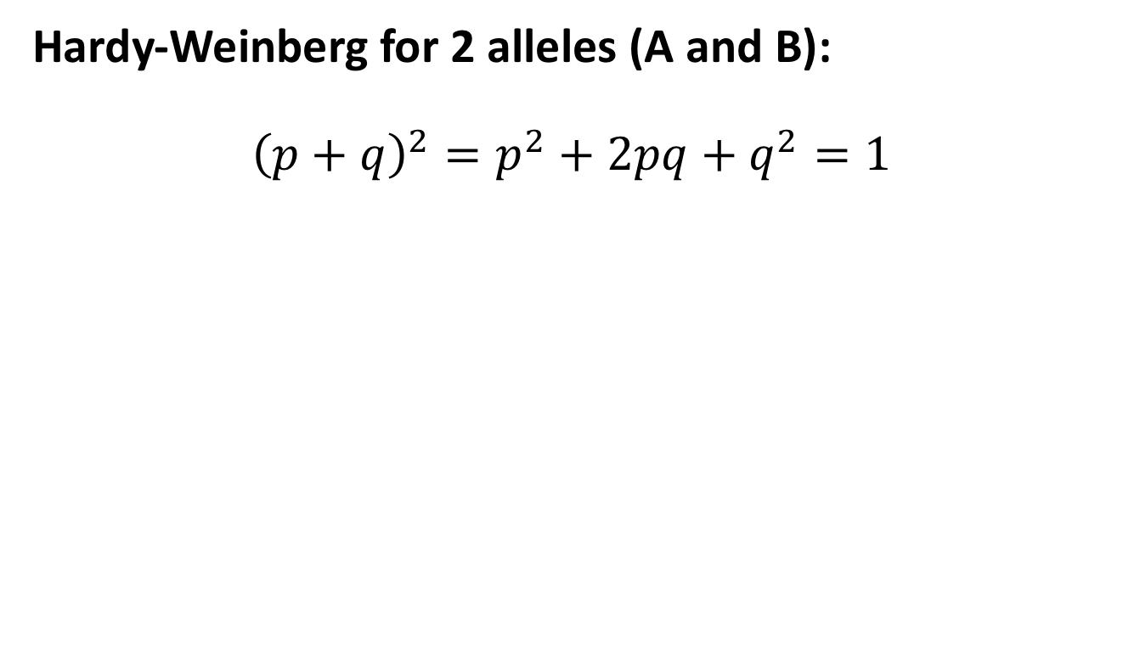
Validating our data: HWE
Hardy-Weinberg for 2 alleles (A and B):
$${\left(p+q\right)}^{2}=p^{2}+2pq+q^{2}=1$$
 | A | B
A | AA | AB
B | AB | BB

Slide 25
Validating our data: HWE
Hardy-Weinberg for 2 alleles (A and B):
$${\left(p+q\right)}^{2}=p^{2}+2pq+q^{2}=1$$
 | A | B
A | AA | AB
B | AB | BB
 | A (p) | B (q)
A (p) | AA (p²) | AB (pq)
B (q) | AB (pq) | BB (q²)

Slide 26
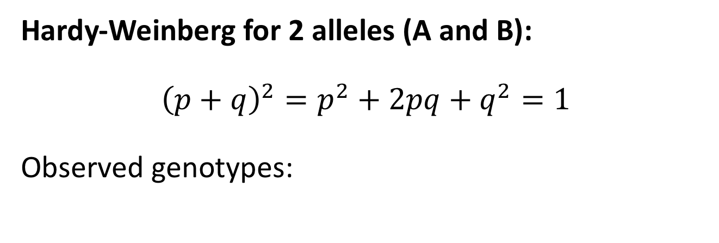
Validating our data: HWE
Hardy-Weinberg for 2 alleles (A and B):
$${\left(p+q\right)}^{2}=p^{2}+2pq+q^{2}=1$$
Observed genotypes:
AA | AB | BB
120 | 280 | 98
=498 individuals

Slide 27
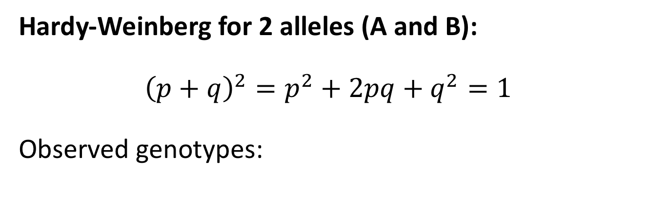
Validating our data: HWE
Hardy-Weinberg for 2 alleles (A and B):
$${\left(p+q\right)}^{2}=p^{2}+2pq+q^{2}=1$$
Observed genotypes:
Observed Frequencies:
AA = 120/498 = .241
AB = 280/498 = .562
BB = 98/498 = .197
AA | AB | BB
120 | 280 | 98

Slide 28
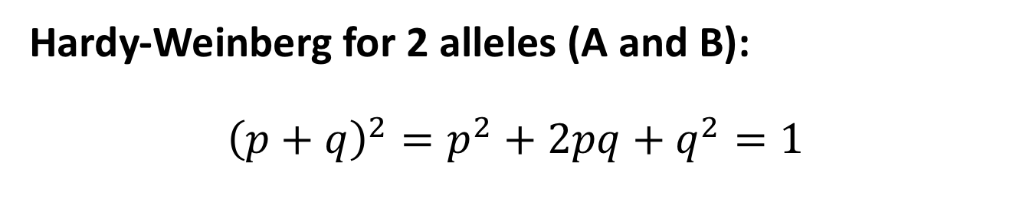
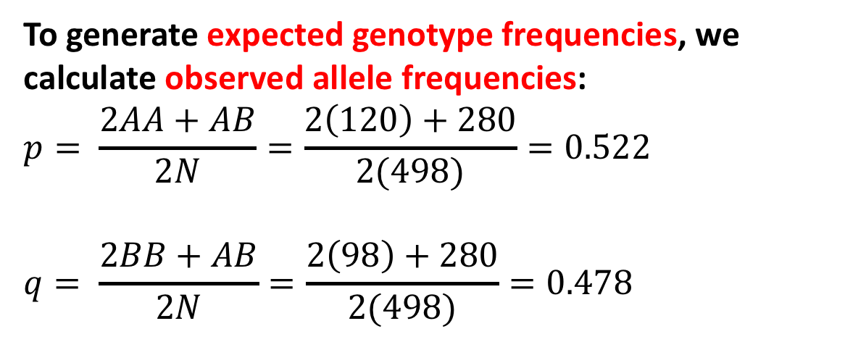
Validating our data: HWE
Hardy-Weinberg for 2 alleles (A and B):
$${\left(p+q\right)}^{2}=p^{2}+2pq+q^{2}=1$$
To generate expected genotype frequencies, we calculate observed allele frequencies:
$$p= \frac{2AA+AB}{2N}=\frac{2\left(120\right)+280}{2(498)}=0.522$$
$$q= \frac{2BB+AB}{2N}=\frac{2\left(98\right)+280}{2(498)}=0.478$$

Slide 29
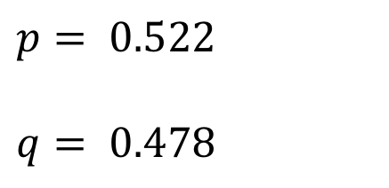
Validating our data: HWE
Hardy-Weinberg for 2 alleles (A and B):
$${\left(p+q\right)}^{2}=p^{2}+2pq+q^{2}=1$$
$$p= 0.522$$
$$q= 0.478$$

Slide 30
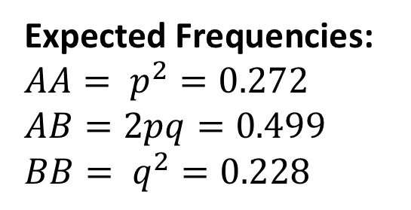
Validating our data: HWE
Hardy-Weinberg for 2 alleles (A and B):
$${\left(p+q\right)}^{2}=p^{2}+2pq+q^{2}=1$$
Expected Frequencies:
$$AA= p^{2}=0.272$$
$$AB=2pq=0.499$$
$BB= q^{2}=0.228$
$$p= 0.522$$
$$q= 0.478$$

Slide 31
Validating our data: HWE
Hardy-Weinberg for 2 alleles (A and B):
$${\left(p+q\right)}^{2}=p^{2}+2pq+q^{2}=1$$
Expected Frequencies:
$$AA= p^{2}=0.272$$
$$AB=2pq=0.499$$
$BB= q^{2}=0.228$
$$p= 0.522$$
$$q= 0.478$$
Observed Frequencies:
AA = 120/498 = .241
AB = 280/498 = .562
BB = 98/498 = .197

Slide 32
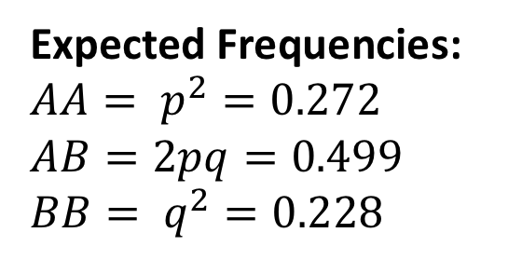
Validating our data: HWE
Hardy-Weinberg for 2 alleles (A and B):
$${\left(p+q\right)}^{2}=p^{2}+2pq+q^{2}=1$$
 | AA | AB | BB
Obs | 120 | 280 | 98
Exp | 135 | 248 | 114
Dev. | -15 | 32 | -16
Expected Frequencies:
$$AA= p^{2}=0.272$$
$$AB=2pq=0.499$$
$BB= q^{2}=0.228$
Multiply each by 498 to get expected counts

Slide 33
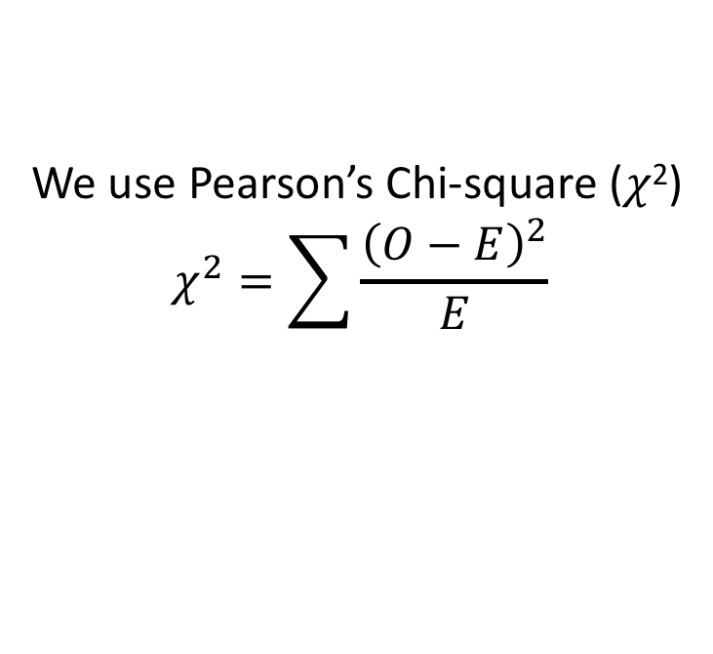
Validating our data: HWE
Hardy-Weinberg for 2 alleles (A and B):
Is this deviation significant??
 | AA | AB | BB
Obs | 120 | 280 | 98
Exp | 135 | 248 | 114
Dev. | -15 | 32 | -16
We use Pearson’s Chi-square (𝜒²)
$$χ^{2}=\sum{\frac{{\left(O−E\right)}^{2}}{E}}$$

Slide 34
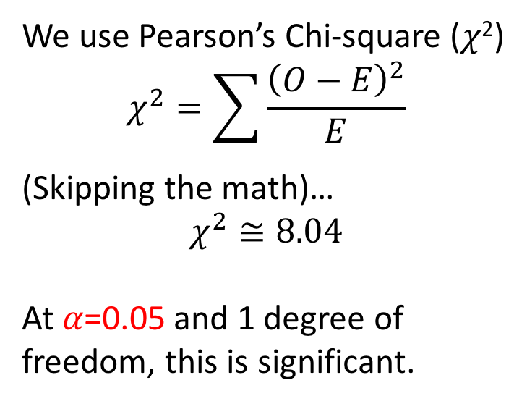
Validating our data: HWE
Hardy-Weinberg for 2 alleles (A and B):
Is this deviation significant??
 | AA | AB | BB
Obs | 120 | 280 | 98
Exp | 135 | 248 | 114
Dev. | -15 | 32 | -16
We use Pearson’s Chi-square (𝜒²)
$$χ^{2}=\sum{\frac{{\left(O−E\right)}^{2}}{E}}$$
(Skipping the math)…
$$χ^{2}≅8.04$$
At 𝛼=0.05 and 1 degree of freedom, this is significant.

Slide 35
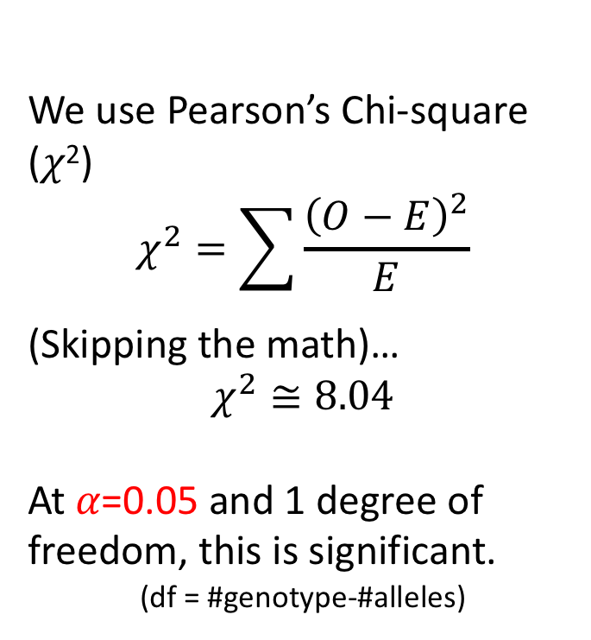
Validating our data: HWE
Hardy-Weinberg for 2 alleles (A and B):
Is this deviation significant??
 | AA | AB | BB
Obs | 120 | 280 | 98
Exp | 135 | 248 | 114
Dev. | -15 | 32 | -16
We use Pearson’s Chi-square (𝜒²)
$$χ^{2}=\sum{\frac{{\left(O−E\right)}^{2}}{E}}$$
(Skipping the math)…
$$χ^{2}≅8.04$$
At 𝛼=0.05 and 1 degree of freedom, this is significant.
(df = #genotype-#alleles)
Maybe slight heterozygote deficiency

Slide 36
Validating our data: HWE
What do deviations in HWE mean?
Assortative mating or population structure
Inbreeding
Selection (e.g. heterozygote deficiency)
Gene flow
Important to note, as could mean assumptions of downstream analyses are violated

Slide 37
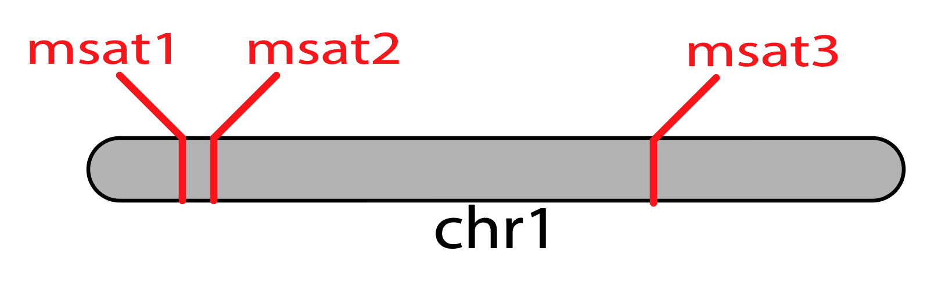
Validating our data: Linkage-disequilibrium
Testing for linkage-disequilibrium (LD)
LD = nonrandom association of alleles at multiple loci
Can result from physical linkage, strong selective co-adaptation, or artefact of sampling

Slide 38
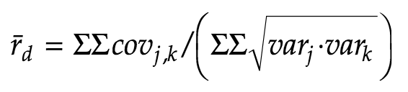
Validating our data: Linkage-disequilibrium
Testing for linkage-disequilibrium (LD)
Statistical vs. physical linkage: We test for statistical associations between alleles. With genomic data, you could directly test for physical associations
Index of association
Agapow and Burt (2005):

Slide 39
Validating our data: Linkage-disequilibrium
What does significant LD mean?
Physical linkage of loci (meaning crossover effects don’t tend to cause recombination between alleles)
Linkage by selection (e.g. co-adaptation)
Artefact of sampling across population structure (e.g. Wahlund effect)
Non-sexuality of organism (e.g. clonal reproduction)

Slide 40
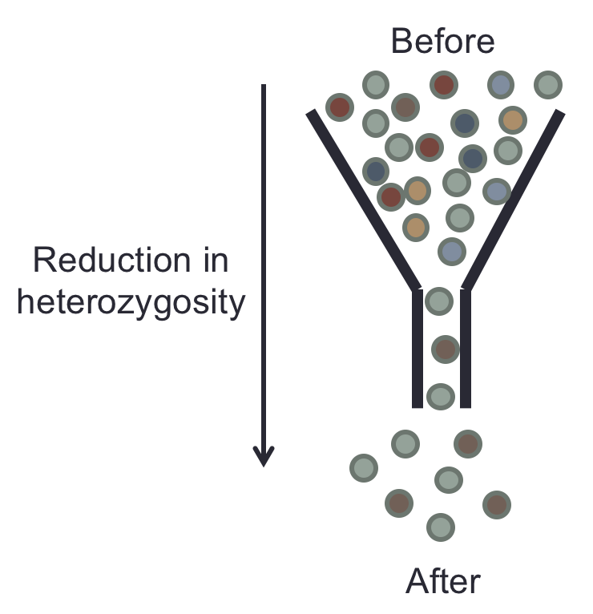
Exploring our data: Genetic diversity
Heterozygosity as a proxy
Ranging from 0 to 1
Values often high for msats in a healthy population (0.7-0.9) due to high mutation rate
Often reported as average heterozygosity
Average per locus
Average per population

Slide 41
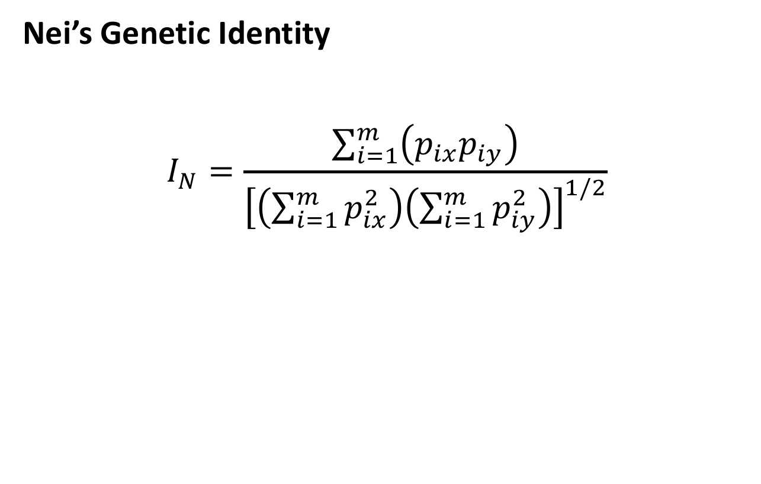
Exploring our data: Genetic identity
Nei’s Genetic Identity
$$I_{N}=\frac{\sum_{i=1}^{m}{\left(p_{ix}p_{iy}\right)}}{{\left[\left(\sum_{i=1}^{m}{p_{ix}^{2}}\right)\left(\sum_{i=1}^{m}{p_{iy}^{2}}\right)\right]}^{1/2}}$$

Slide 42
Exploring our data: Genetic identity
Nei’s Genetic Identity
$$I_{N}=\frac{\sum_{i=1}^{m}{\left(p_{ix}p_{iy}\right)}}{{\left[\left(\sum_{i=1}^{m}{p_{ix}^{2}}\right)\left(\sum_{i=1}^{m}{p_{iy}^{2}}\right)\right]}^{1/2}}$$
For each allele i

Slide 43
Exploring our data: Genetic identity
Nei’s Genetic Identity
$$I_{N}=\frac{\sum_{i=1}^{m}{\left(p_{ix}p_{iy}\right)}}{{\left[\left(\sum_{i=1}^{m}{p_{ix}^{2}}\right)\left(\sum_{i=1}^{m}{p_{iy}^{2}}\right)\right]}^{1/2}}$$
Multiply frequency in pop x and y

Slide 44
Exploring our data: Genetic identity
Nei’s Genetic Identity
$$I_{N}=\frac{\sum_{i=1}^{m}{\left(p_{ix}p_{iy}\right)}}{{\left[\left(\sum_{i=1}^{m}{p_{ix}^{2}}\right)\left(\sum_{i=1}^{m}{p_{iy}^{2}}\right)\right]}^{1/2}}$$
Add up squared frequencies for pop x

Slide 45
Exploring our data: Genetic identity
Nei’s Genetic Identity
$$I_{N}=\frac{\sum_{i=1}^{m}{\left(p_{ix}p_{iy}\right)}}{{\left[\left(\sum_{i=1}^{m}{p_{ix}^{2}}\right)\left(\sum_{i=1}^{m}{p_{iy}^{2}}\right)\right]}^{1/2}}$$
Times the sum of squared frequencies for pop y

Slide 46
Exploring our data: Genetic identity
Nei’s Genetic Identity
$$I_{N}=\frac{\sum_{i=1}^{m}{\left(p_{ix}p_{iy}\right)}}{{\left[\left(\sum_{i=1}^{m}{p_{ix}^{2}}\right)\left(\sum_{i=1}^{m}{p_{iy}^{2}}\right)\right]}^{1/2}}$$
Take the square root of that product

Slide 47
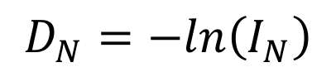
Exploring our data: Genetic identity
Nei’s Genetic Identity
$$I_{N}=\frac{\sum_{i=1}^{m}{\left(p_{ix}p_{iy}\right)}}{{\left[\left(\sum_{i=1}^{m}{p_{ix}^{2}}\right)\left(\sum_{i=1}^{m}{p_{iy}^{2}}\right)\right]}^{1/2}}$$
Nei’s Identity generally expressed as Nei’s Distance:
$$D_{N}=−ln\left(I_{N}\right)$$

Slide 48
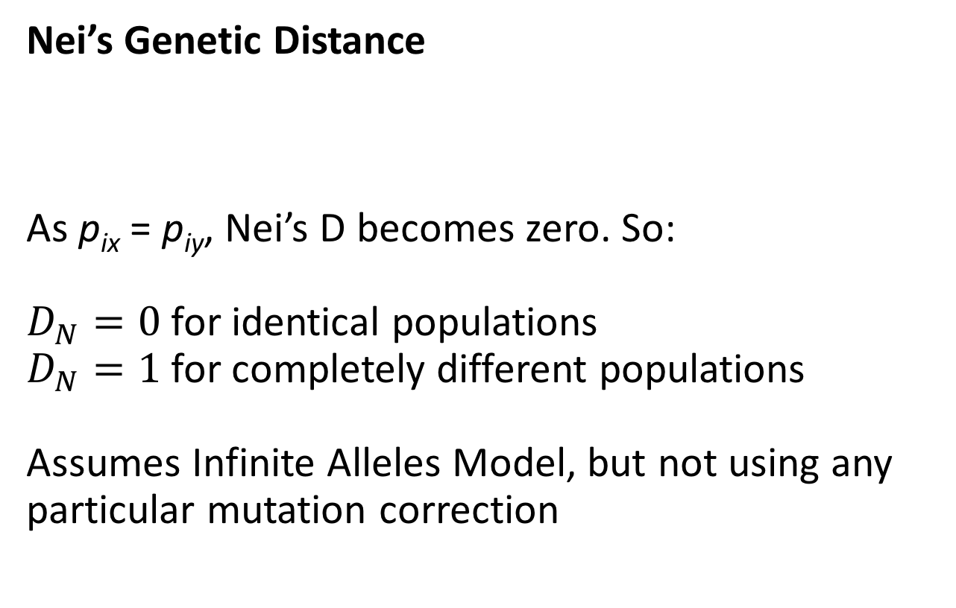
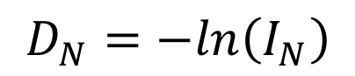
Exploring our data: Genetic distance
Nei’s Genetic Distance
As p_{ix} = p_{iy}, Nei’s D becomes zero. So:
$D_{N}=0$ for identical populations
$D_{N}=1$ for completely different populations
Assumes Infinite Alleles Model, but not using any particular mutation correction
$$D_{N}=−ln\left(I_{N}\right)$$

Slide 49
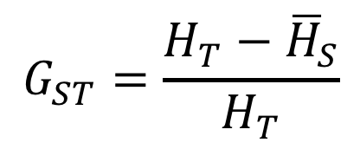
Exploring our data: Genetic distance
F-statistics
Or more commonly calculated, G_{ST}
Also assumes Infinite Alleles Model
$$G_{ST}=\frac{H_{T}−{\overline{H}}_{S}}{H_{T}}$$

Slide 50
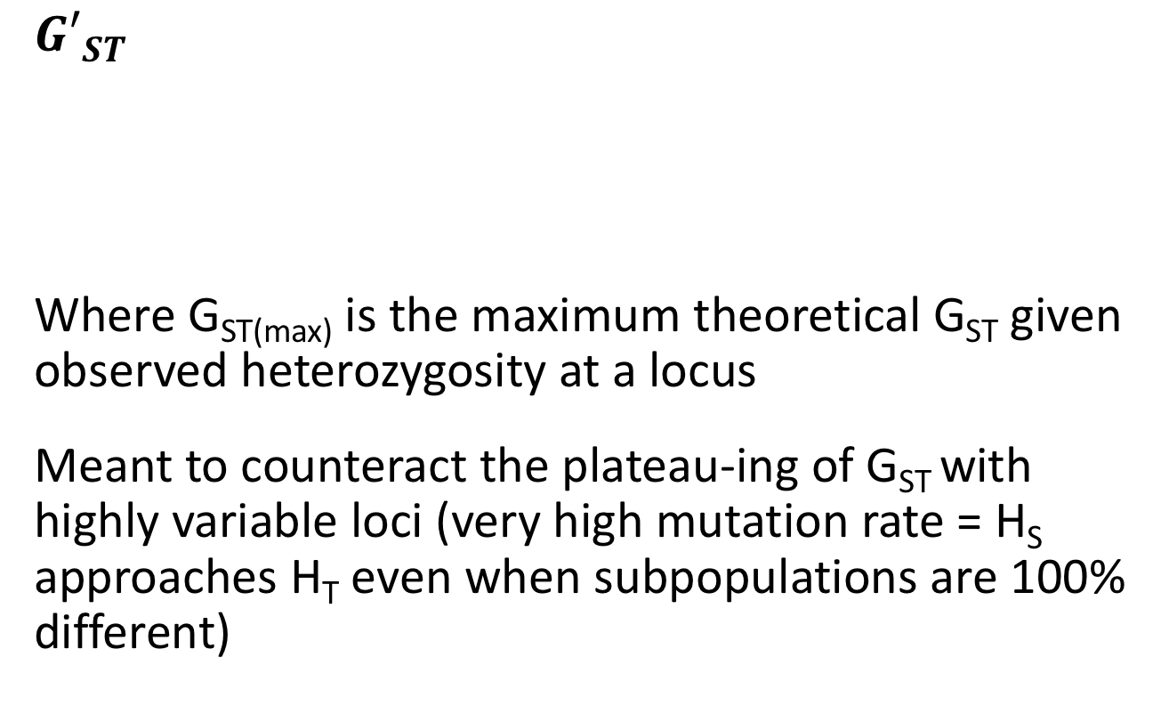
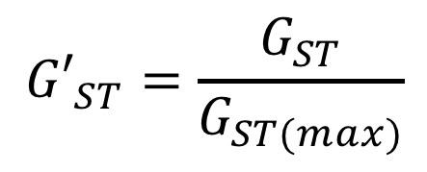
Exploring our data: Genetic distance
$${G′}_{ST}$$
Where G_{ST(max)} is the maximum theoretical G_{ST} given observed heterozygosity at a locus
Meant to counteract the plateau-ing of G_{ST} with highly variable loci (very high mutation rate = H_{S} approaches H_{T} even when subpopulations are 100% different)
$${G′}_{ST}=\frac{G_{ST}}{G_{ST(max)}}$$

Slide 51
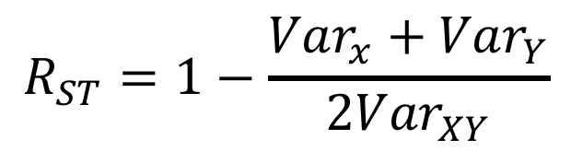
Exploring our data: Genetic distance
R_{ST} – Assuming SMM
Calculated from variance in allele sizes, whereas F_{ST} considers variance in allele frequencies
Since it assumes that disparity in allele size is equivalent to greater divergence, it implicitly assumes a stepwise-mutation model
$$R_{ST}=1−\frac{{Var}_{x}+{Var}_{Y}}{{2Var}_{XY}}$$

Slide 52
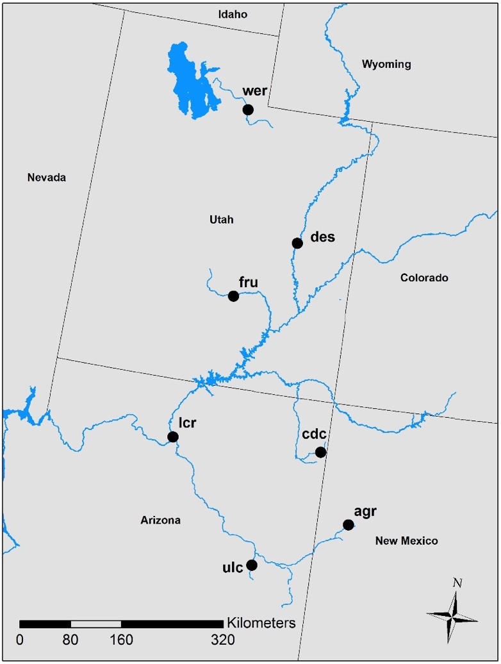
Exploring our data: Understanding genetic distance
Isolation-by-distance
In dispersal-limited species, we might expect genetic distance to increase with geographic distance
We can directly test if geographic distance is a barrier to gene flow by looking for patterns consistent with IBD

Slide 53
Exploring our data: Understanding genetic distance
IBD: Mantel test
Tests for correlation between two matrices
X-matrix (independent): geographic distance
Y-matrix (dependent): genetic distance
Calculates correlation coefficient (Pearson’s r) of the two matrices
Test for significance using permutation
i.e. shuffle around the Y matrix, see if correlation persists

Slide 54
Exploring our data: Understanding genetic distance
IBD: Mantel test

Slide 55
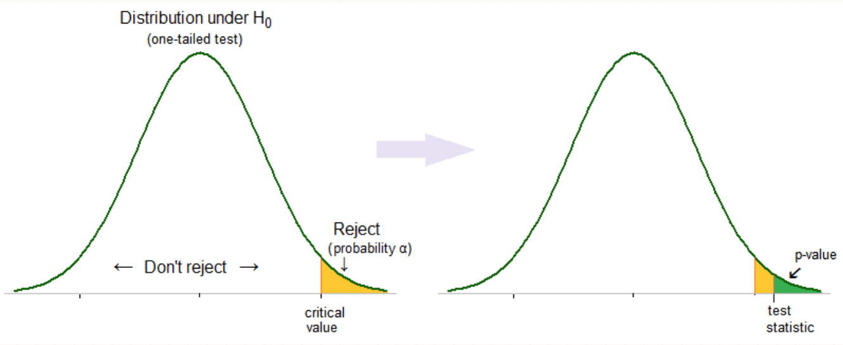
Final note: Bonferroni correction
In a single test, the 𝛼 value is a threshold for p, or how often we expect to see more extreme values by random chance

Slide 56
Final note: Bonferroni correction
When computing multiple tests, the probability of seeing a more extreme value by chance is increased.
As a result, we increase the chance of falsely rejecting the null hypothesis (Type I error)
One way to compensate is to use a Bonferroni adjusted 𝛼 value

Slide 57
Final note: Bonferroni correction
Bonferroni adjustment:
𝛼/N, where N = number of tests performed
Ex: If your 𝛼=0.05, and you conducted 10 tests, the Bonferroni adjusted 𝛼 value would be 0.005
p<0.005 = significant for this scenario

Slide 58

Today’s Dataset
Bluehead Sucker
7 populations from the Colorado River and Bonneville basins in the Southwestern US
16 microsatellite loci

